Slide 1
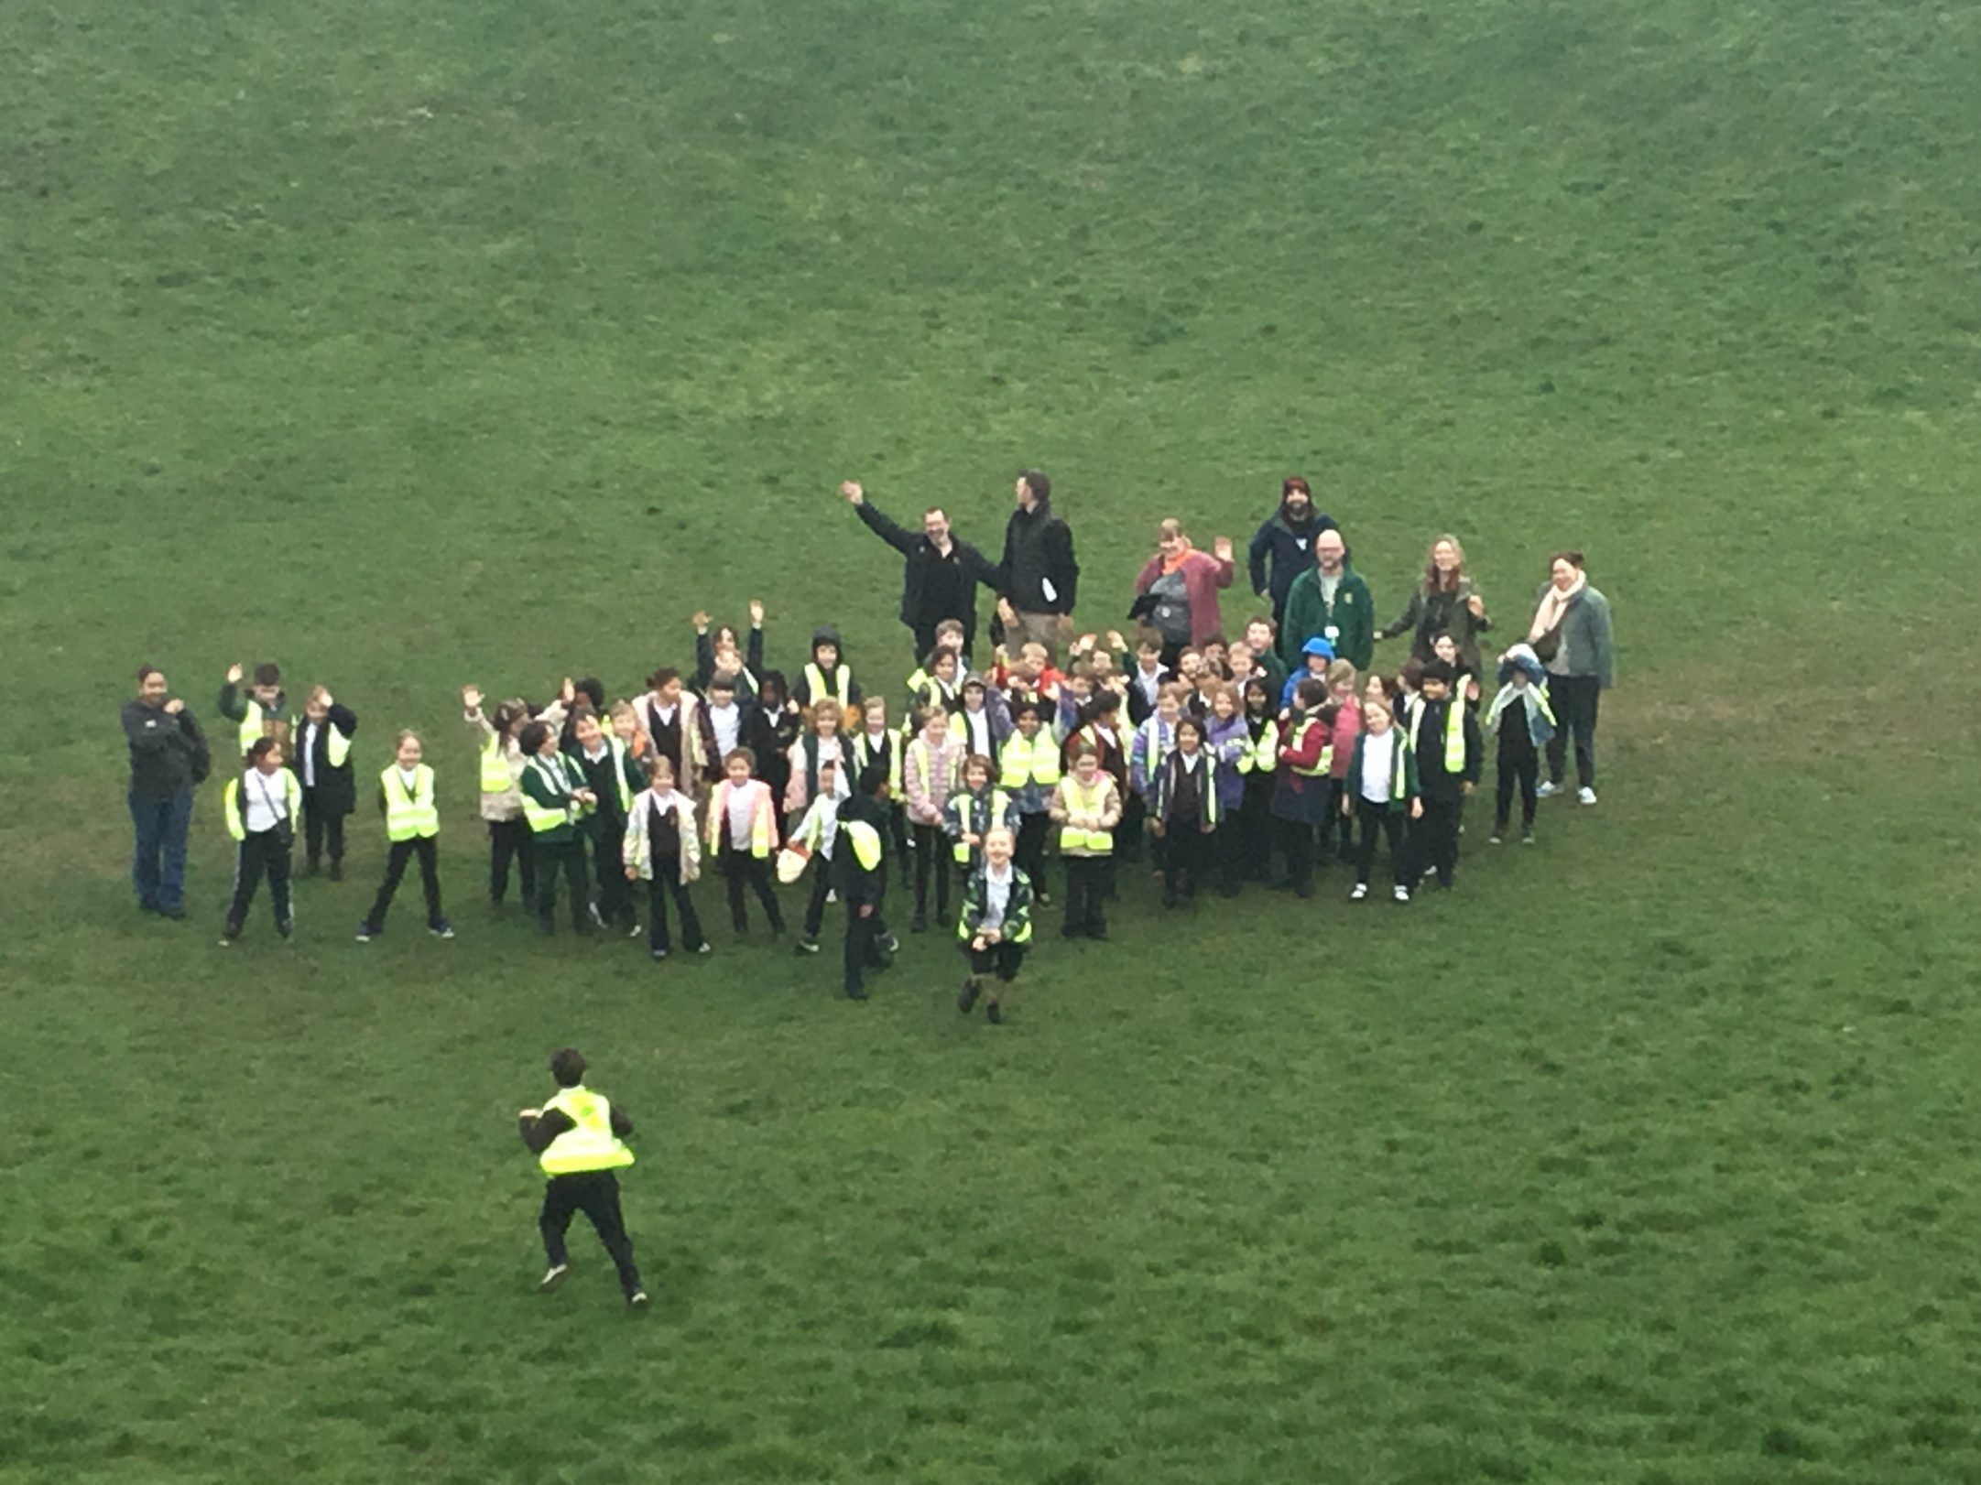
Summer Term - Year 3 Meet the Teacher

Slide 2
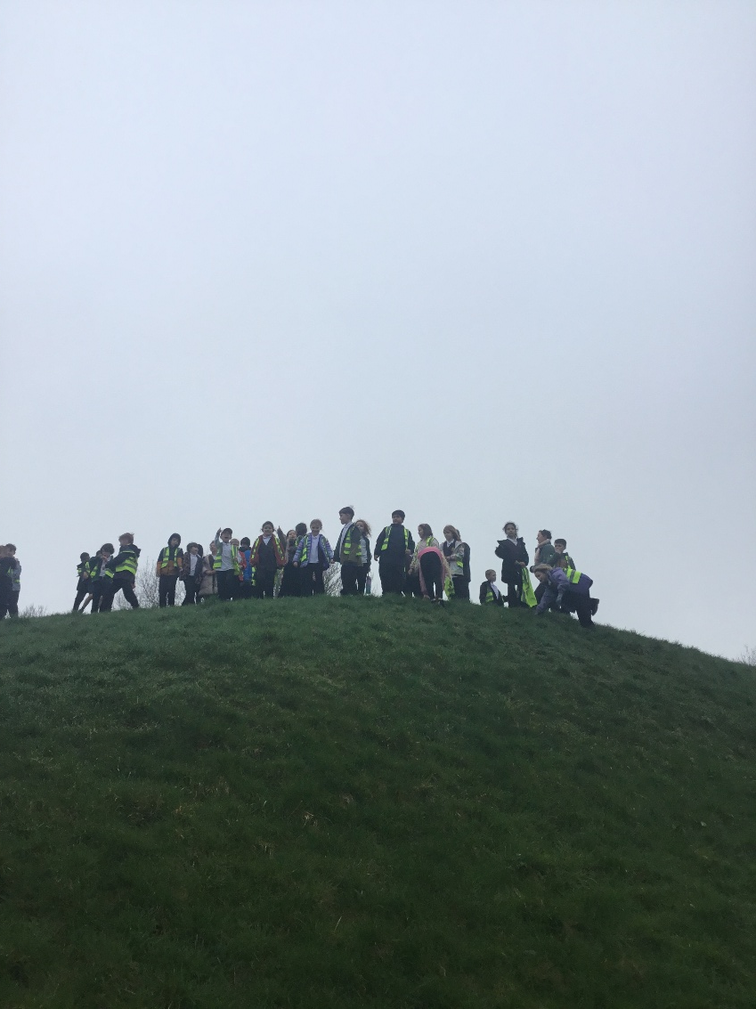
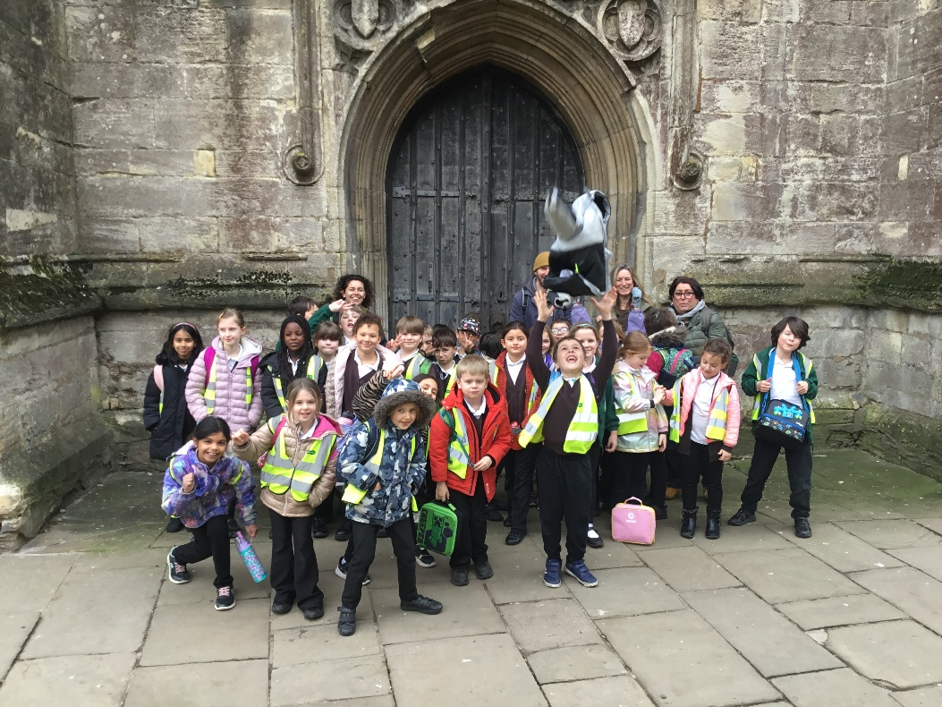
Welcome
Summer term curriculum
Homework reminder
Dates for your diary
Any questions

Slide 3
CanDo Maths
Money – finishing off
Time – You can help!
Measurement - length, capacity, mass, perimeter
Geometry – properties of shapes(angles)
Statistics
We will be recapping multiplication and division units this term – during MOT and homework tasks

Slide 4
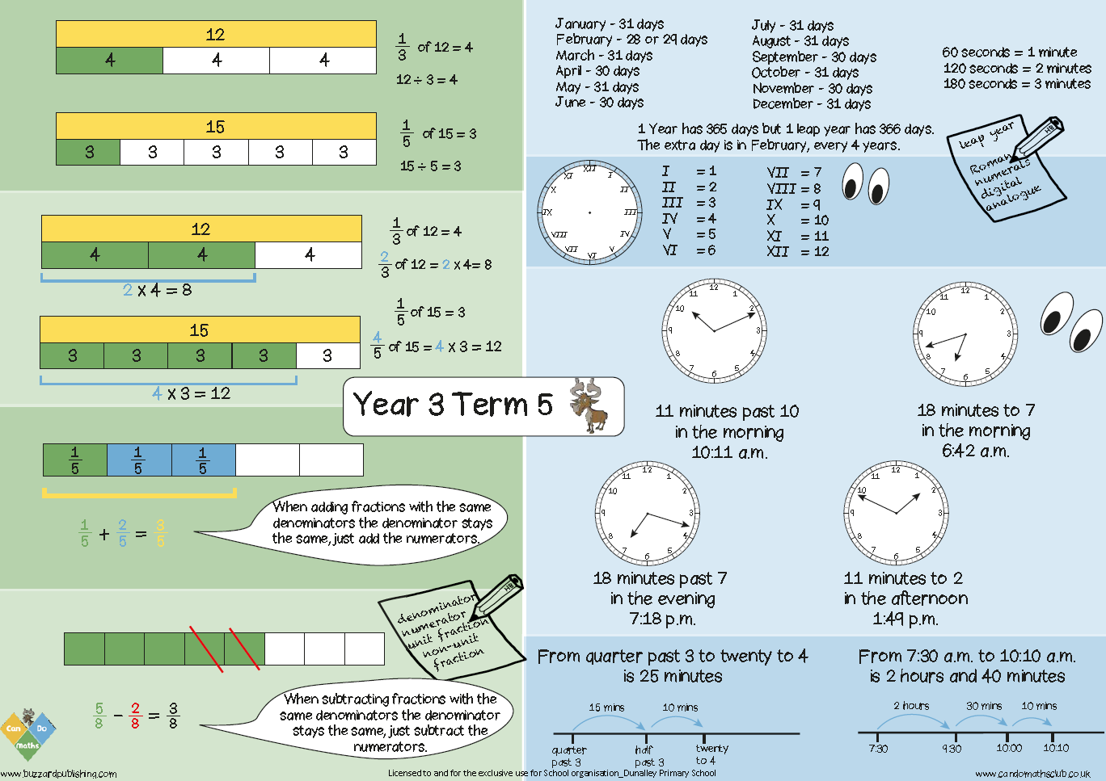
Copy for parents

Slide 5
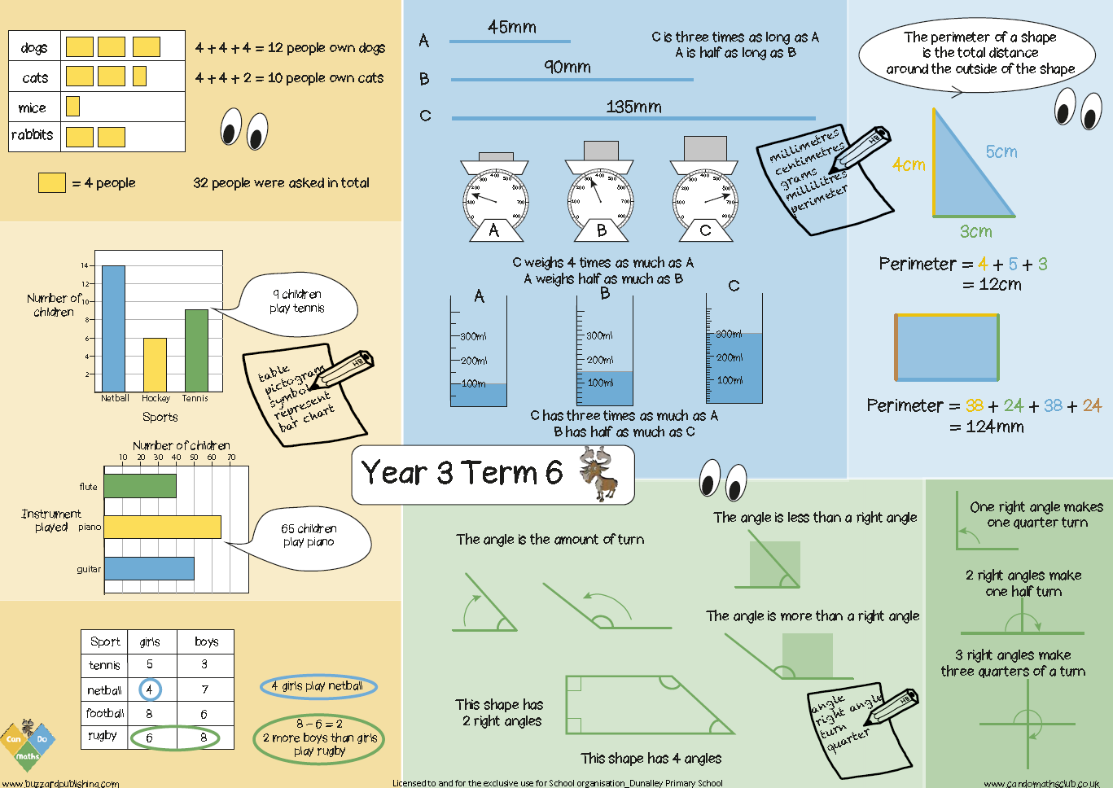
Copy for parents
Copy for parents

Slide 6



English - Writing
The Green Ship – focus on conjunctions, writing parts of a finding story
The Promise – writing a persuasive letter – 10 sessions
Cheltenham – writing a tourist guide for Cheltenham -10 sessions

Slide 7
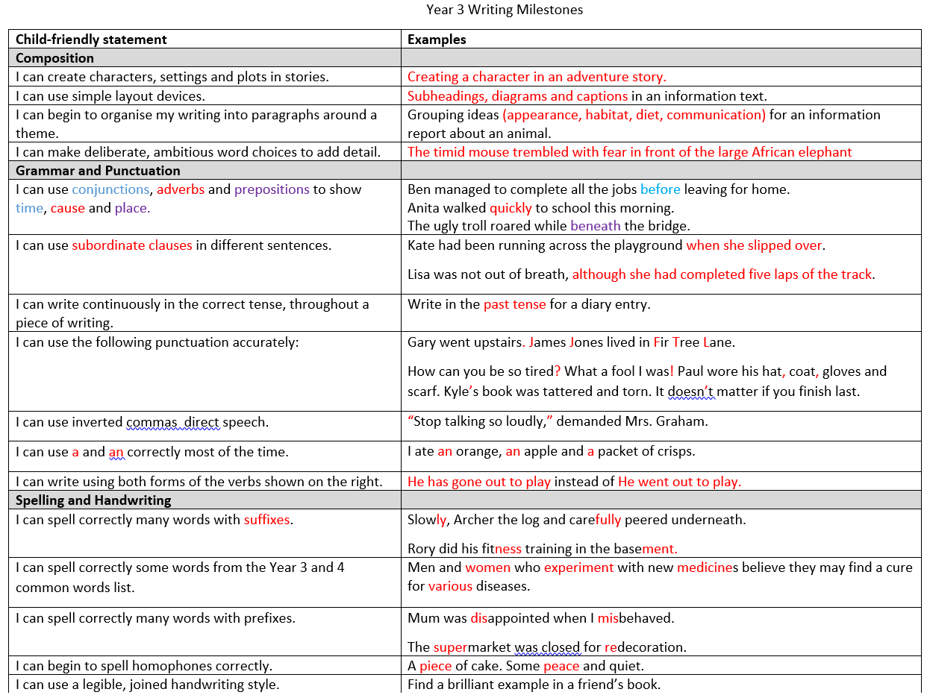
Writing Expectations
By the end of Year 3
Copies available

Slide 8


Guided Reading
Ariki and the Giant Shark – Nicola Davies
Bill’s New Frock - Anne Fine

Slide 9
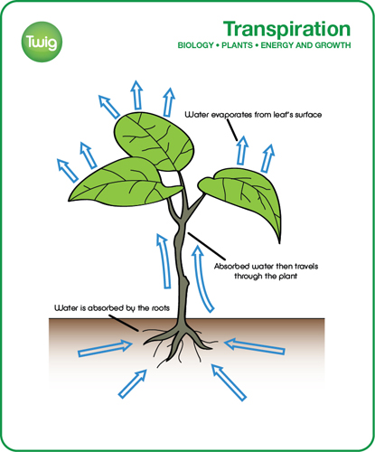
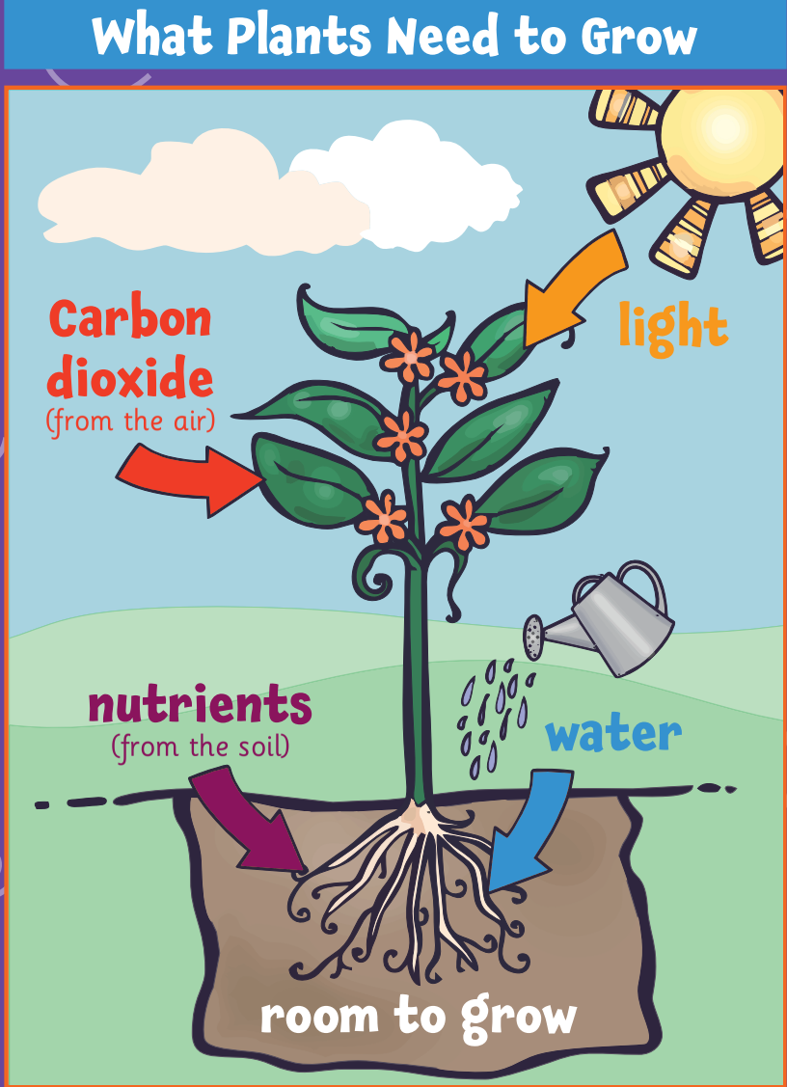
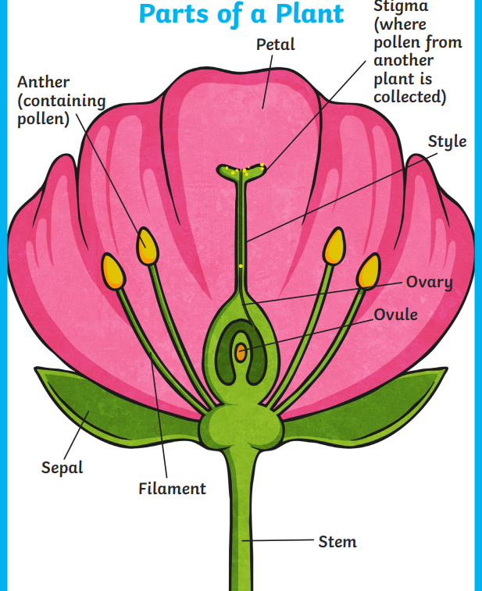
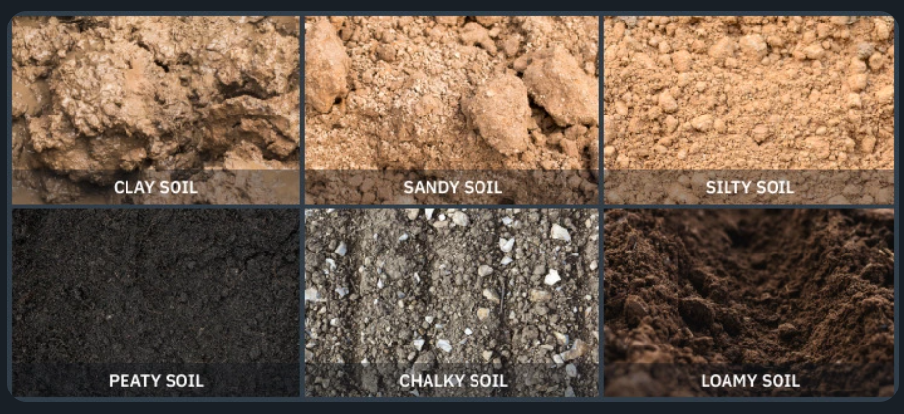
Science
Plants

Slide 10
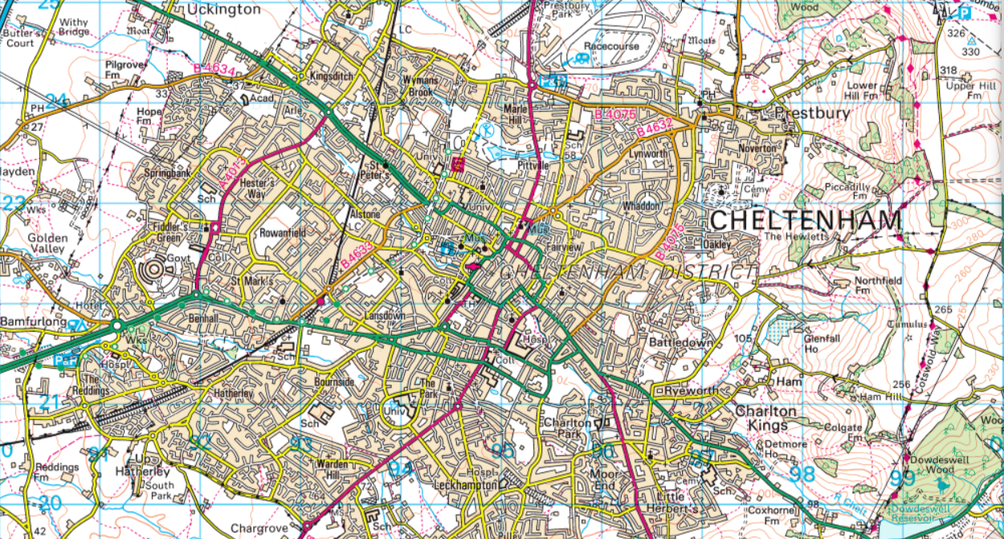
Geography
A geographical study of Cheltenham – homework this week

Slide 11
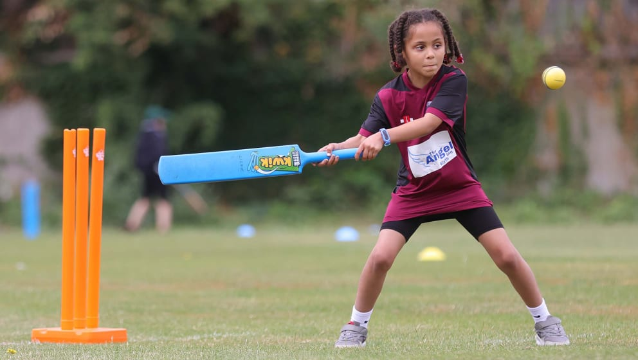
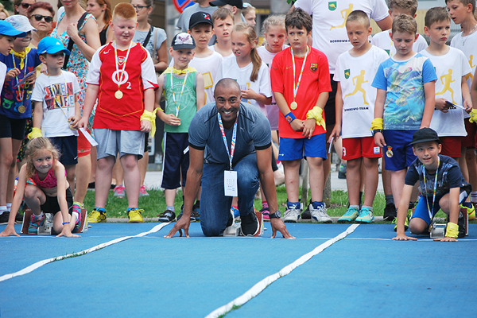
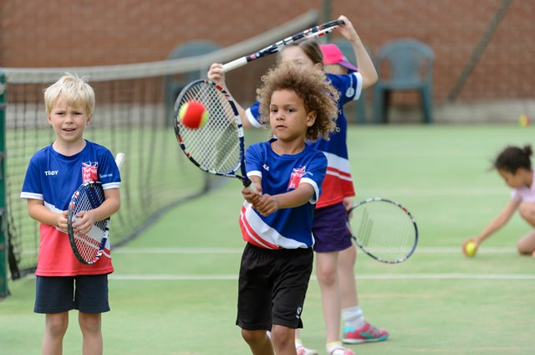
PE
Summer 1: Athletics (3A - Monday and Thursdays 3OF - Tuesday and Friday)
Summer 2: Cricket and Tennis

Slide 12
PE Uniform – Thank you!
PE Kit Reminder for Parents
On PE days, children must come to school wearing their PE kit, as pupils do not change at school.
The correct PE kit is:
White polo shirt
Black PE shorts or black jogging bottoms or black leggings (plain, no patterns)
Plain black trainers
Brown jumper, brown cardigan or green fleece with the school logo (to be worn over the PE kit if needed)
Extra pair of trainers (if PE session is on the field)

Slide 13
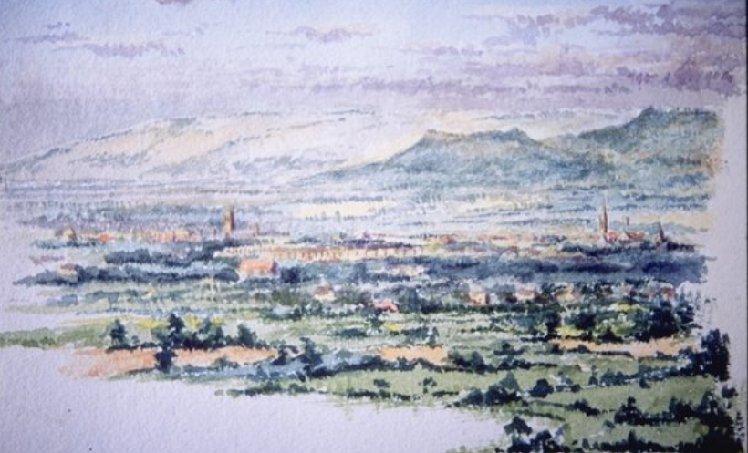
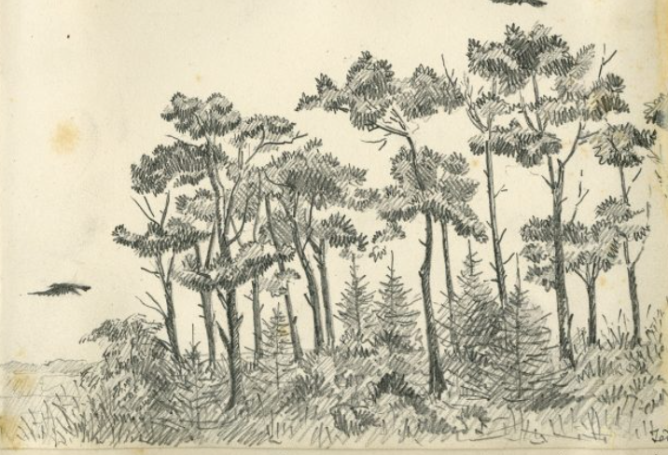
Art
Painting – images of Cheltenham
A study of Edward Wilson

Slide 14

Design Technology
Textiles - Design and make a pennant( to reflect a Cheltenham landmark)

Slide 15

French and RE
French - The Seasons
RE - How and why do people (in 3 traditions) use ceremonies to show their commitments?

Slide 16

PSHE and Music
PSHE - Healthy Me and RSE
Music - Genre: Various Title: Fly with the stars – classroom percussion

Slide 17
Homework Reminder
Home reading - 20 minutes daily will make all the difference. Remember to sign the reading diary.
Times tables supported by TTRS – 5 minutes daily to secure the knowledge of the following facts x2,x5,x10,x3,x4,x8 – paper copy workbooks available, 2x sessions per week in school
Key words from the Year 3 list(summer 1 and recap full list across the year)
Additional spellings based on taught patterns this term
Personal list based on spelling target – Y1/Y2 HFW’s

Slide 18
Dates For Your Diary
University Maths morning – Tuesday 21st April – Leave 9.55am – x3 Parent helpers
Design technology morning – Friday 3rd July
Sports Day – Tuesday 7th July
Walks around Cheltenham (Geography) – TBC
THANK YOU from the Year 3 team!
Final term in Year 3.

