Slide 1
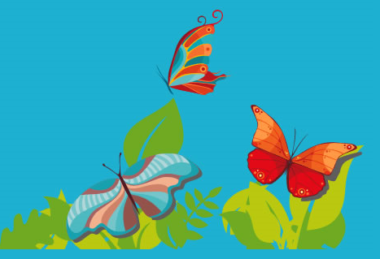
YR parents meeting
Summer term 2026

Slide 2
A typical day
Phonics- Read Write Inc (Friday whole class assembly)
Wake and shake/ movement break/ track
Whole class Handwriting
Adult-directed activities, self-initiated play and snack (or PE)
Whole class Mastering number maths
11.30-12.30 Lunch
Whole class input (e.g. Can do maths, literacy)
Adult-directed activities and self-initiated play
Circle time
Story

Slide 3
Summer term
PE- Games and ball skills
Jigsaw- Healthy Me
RE
UW assessment- Eggsonaut and floating and sinking
Can do maths
Mastering number
Handwriting (in letter families)
Writing (linked to selected texts)
Picture News
E-safety

Slide 4
Reading homework
Your child should continue to bring home one reading book and one library book each week.
Record in yellow reading books.
Aim to read with your child at least 5 times a week.
Reading should be pleasurable (not too tricky!)
Do not hesitate to let us know if your child finds their book too easy/hard.
Reading should include a wide range of fiction and non-fiction books
What?
How?
Who?
Where?
When?
Why?

Slide 5
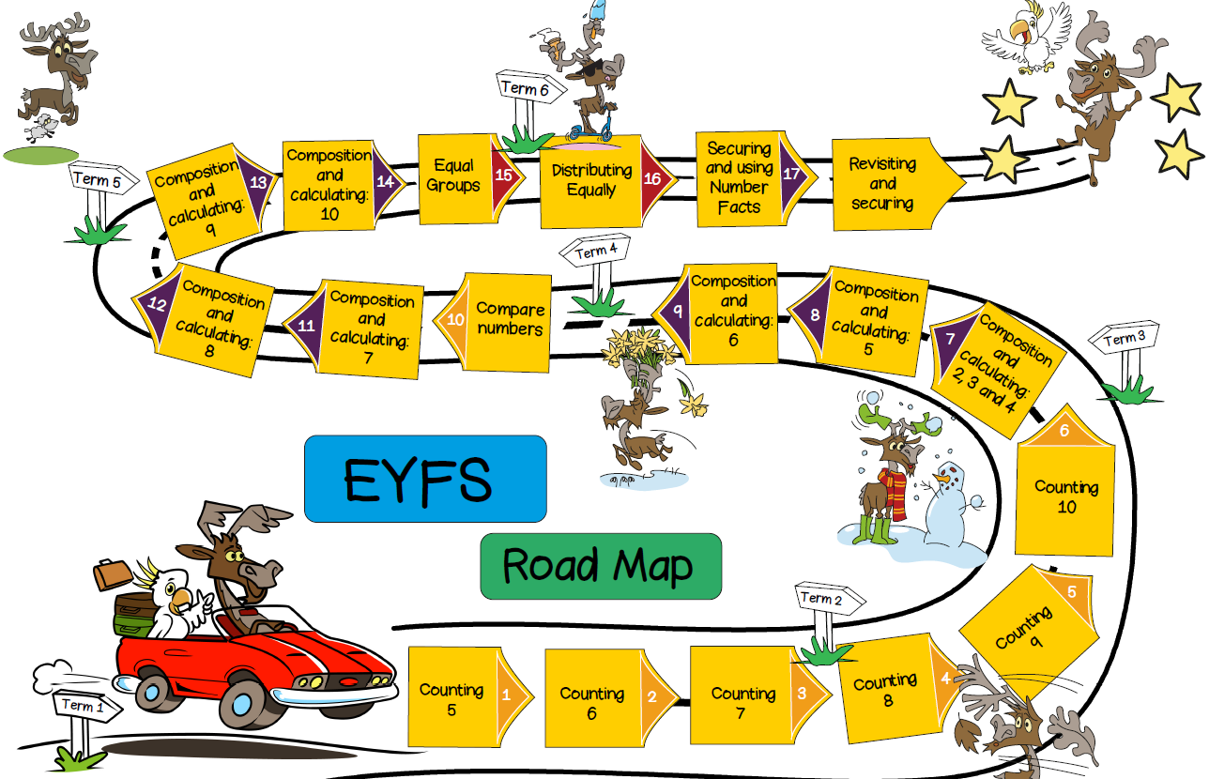
Maths

Slide 6
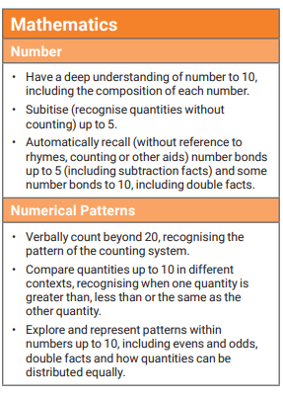
Maths expectations- end of year

Slide 7
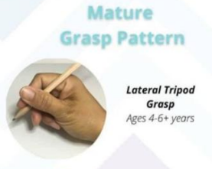
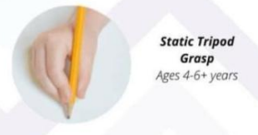
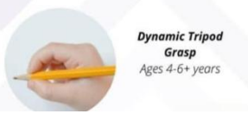
Literacy
3 week model- the research station, the writing table and the publishing zone
Handwriting
Pencil grip

Slide 8
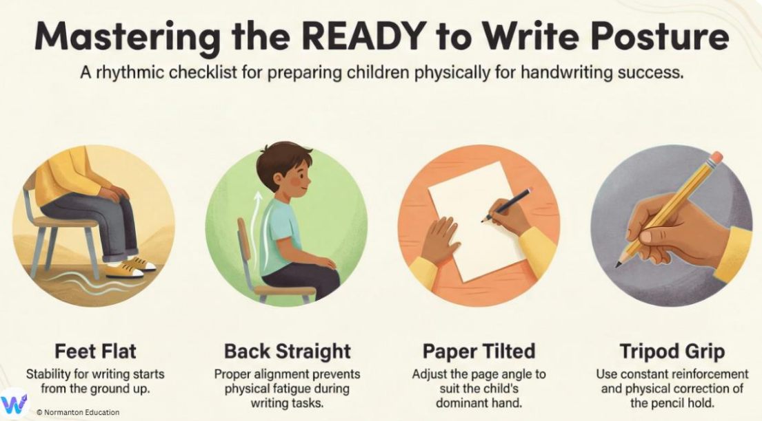

Slide 9
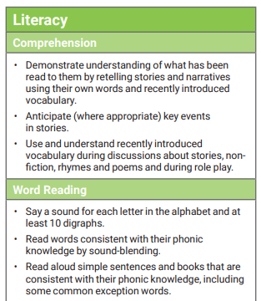
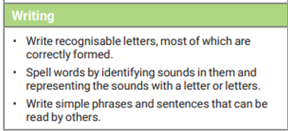
Literacy expectations- end of year

Slide 10
Reminders
As the weather changes please ensure your child has:
A named bottle containing water
Sun hat
Spare change of clothes

Slide 11
Please do come and see us if you have anything that you would like to talk about.

